Slide 1

GAIA System
Workflow, by Orko Bairagi

Slide 2
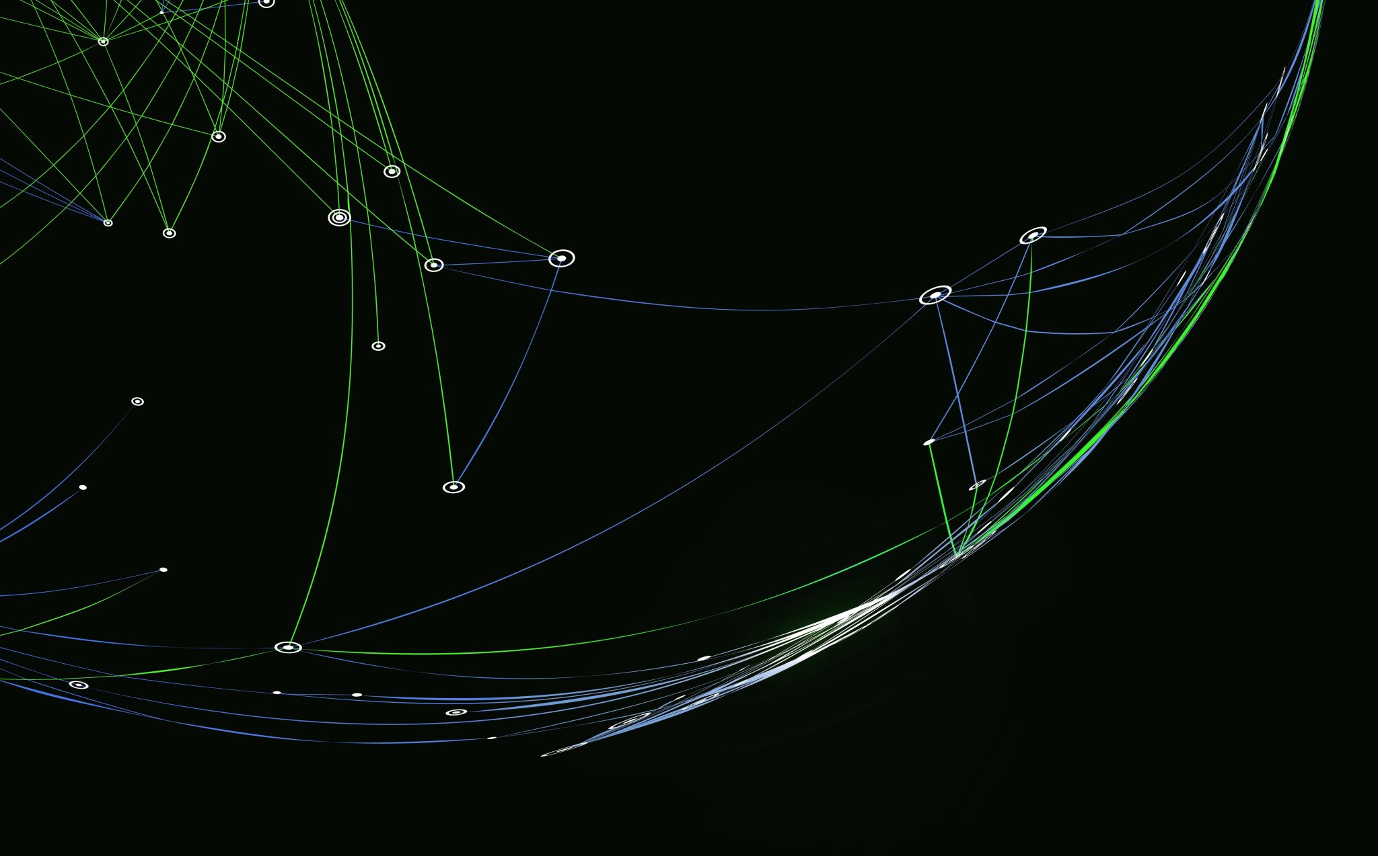
Main objective
Provide detailed routes and satellite coverage data:
Use ETL, Machine Learning Algorithms and Interactive GUI to display an alpha (advantageous) route in any terrain.
Returns customized solution.

Slide 3

3 main features:
3 main objectives:
On-road routes
Off-road routes
Satellite Tracking info

Slide 4
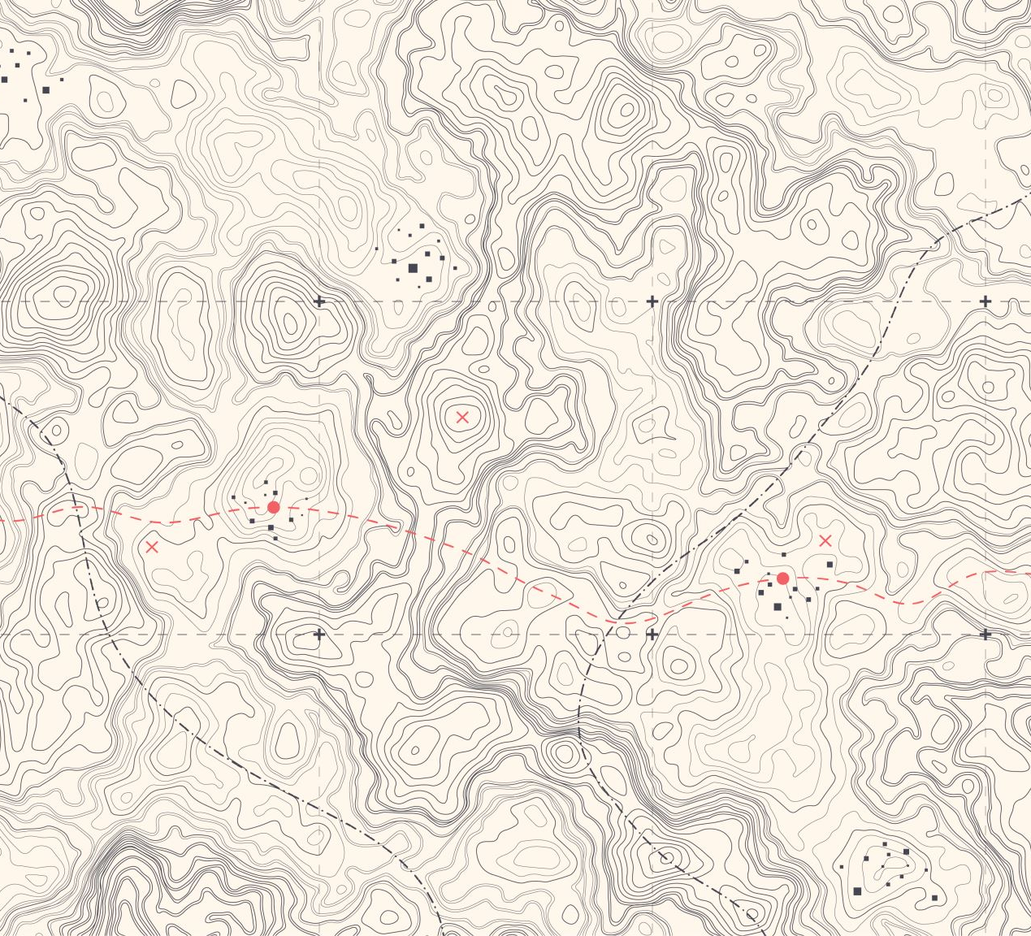
Front End GUI
The Front End GUI is designed to be interactive for user to upload any files according to feature design (road maps, terrain feature, elevation, etc.)
From the GUI a REST API is designed under a Foundary Framework I’m assuming where data is forced into a pipeline for processing

Slide 5
Backend Engine
The Backend Engine takes from the Foundary Framework and sorts it out to the required Machine Learning and models based on user prompts, takes data and runs it through required methods to generate an alpha decision for the user.
Main objective is to maximize route efficiency given user requirements, (vehicle type, terrain fuel type etc.) while keeping track of satellite tracking.
Refer knock off GAIA logic to see my attempt to re-engineer it in 6 days.

